Slide 1
POLS 208: Week 13
Quang Bui

Slide 2
Agenda
Types of Data
Difference-in-Differences (DiD) and Regression Discontinuity Design (RDD)
Instrumental Variables (IV)

Slide 3
Types of Data
Concept to get understand for final:
Operationalization: How to define a concept into a measurable indicator
Think about different measures of variables based on the theory
Categorical, binary, continuous
Qualities of good measures
Measurable
Avoids issues addressed in the theory
Interpretable

Slide 4
Difference in Differences (DiD)
Main take away for final
Estimates post-treatment effect by comparing differences in differences between control and treatment
Parallel Trends Assumption
Estimates causal effect by comparing the changes in the treatment group to a control group after the treatment is applied
Why is it useful?
Unobservable counterfactual
Potential lack of randomization of treatment
Differences in characteristics between treatment and control (e.g. differences between rich and poor)
Notes:
Give students 10 minutes to read, discuss for about 15. 25 min
Activity give students 10-15 minutes to discuss. 40 min
Talk about in general what works and what doesn’t for 10 minutes. 50 min

Slide 5
DiD – How it’s estimated
Step 1: what is the difference between the treatment and control group BEFORE the treatment?
Step 2: what is the difference between the treatment and control group AFTER the treatment?
Step 3: Causal effect = Post Treatment Difference – Pre Treatment Difference
Notes:
Give students 10 minutes to read, discuss for about 15. 25 min
Activity give students 10-15 minutes to discuss. 40 min
Talk about in general what works and what doesn’t for 10 minutes. 50 min

Slide 6
When can we use DiD?
Parallel Trends
The rate of change in the dependent variable BEFORE treatment is similar between treatment and control group
Ensures that we can estimate a counterfactual
No spillovers
Members of the control group do not get the treatment or are affected by the treatment
Notes:
Give students 10 minutes to read, discuss for about 15. 25 min
Activity give students 10-15 minutes to discuss. 40 min
Talk about in general what works and what doesn’t for 10 minutes. 50 min

Slide 7
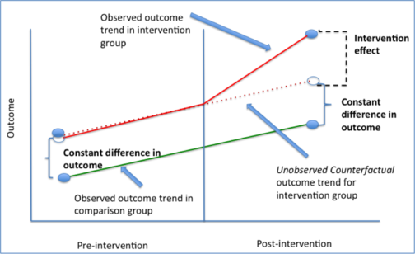

Slide 8
Regression Discontinuity Design (RDD)
Main takeaway
Requires a sharp cutoff between treatment and control
Estimates counterfactual by using units around a strict cutoff
Those who are barely over the cutoff are the treatment group and those that barely miss the cutoff are the control
Why is this useful?
Very similar control group
Can help to prevent selection bias if cutoff is exogenous

Slide 9
When can we use RDD?
Cutoff is determined on a continuous variable
Cutoff is strict
We want the two groups to be as random as possible
The differences between a person making 4.0 GPA and a person making a 3.9 is probably really minor and random

Slide 10
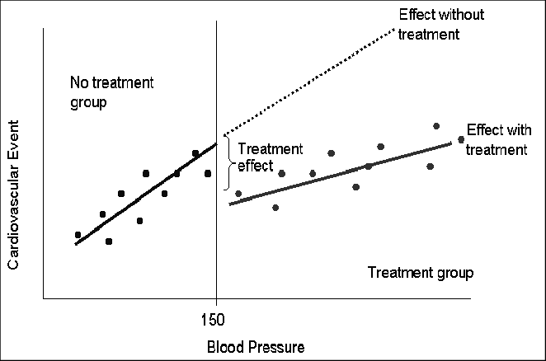

Slide 11
Instrumental Variable (IV)
Main takeaway:
Independent variable “X” is influenced by the dependent variable “Y”
Need to find some variable “Z” that helps us avoid endogeneity

Slide 12
Depression may cause smoking
Instrument Restriction
Smoking
Depression
Taxes on Cigarettes
X
Y
Cigarette taxes cause depression
Instrument Restriction

Slide 13
DiD, RDD, and IV Activity
Discuss in groups whether to use DiD or RDD in the following scenarios. Also consider the limitations of these designs in each
Estimating the impact of New Jersey’s minimum wage law on unemployment in New Jersey and Pennsylvania
Determining the effects of the HOPE scholarship on college completion in Georgia
Evaluating the effects of increasing Medicaid eligibility on healthcare outcomes in the Affordable Care Act
Determining the effects of historical racial violence on voting behavior

Slide 14
Thanks for a great semester!
Quiz – Due today
Final Draft – 12/3
Exam – 12/11

Slide 15
Email: quang.bui@emory.edu
Office Hours: M 2-3
Tarbutton 116

